Slide 1

Investment Portfolio Composition
David Simbandumwe | DATA 618 Fall 2023 w3

Slide 2
Random Number Generator - Scenario 3
You are a 40-year-old divorcee. You own a successful business and have recently received an $8.0 million buyout offer from a competitor that you want to accept. Your remaining assets are stocks of companies that are your suppliers valued today at $1.2 million and cash in several accounts totaling $62,000.
Notes:
Assume income over $492,301 for tax purposes
Assume taxes on capital gains transaction is $2,544,360 - Fed and NY State (31.8%)
https://www.1031gateway.com/capital-gains-tax-calculator/

Slide 3
Financial Profile
Financial Goals?
capital preservation - protecting the value generated from the business that he built over the years
tax planning - minimize tax exposure
retirement planning - plan for early retirement
Investment Timeline?
long-term - there is enough income for immediate needs and supports financial goals
Risk Appetite?
average risk tolerance - at 40 there is still time in the market to navigate downturns

Slide 4
Portfolio Construction
Asset Class | Sub Class | Allocation | Value
Economically Sensitive Exposures | U.S. Equities | 25.0% | 1,675,000
 | International Equities | 10.0% | 670,000
 | Emerging Market Equities | 5.0% | 340,000
 | Publicly Traded REITs | 10.0% | 670,000
 | Private Equity | 5.0% | 335,000
 | Long/Short Equities | 5.0% | 335,000
 |  | 60.0% | 4,025,000
Interest Rate Sensitive Exposures | U.S. Government Bonds | 20.0% | 1,350,000
 | Very-High-Quality Corporate Bonds | 7.5% | 500,000
 | Very-High-Quality Municipal Bonds | 7.5% | 500,000
 |  | 35.0% | 2,350,000
Cash on hand | Cash | 5.0% | 342,500
allocation - Whitwell and Villalta did not propose a target allocation for new taxonomy
60/40 portfolio proposed here includes PE and other “alternative investments”
added cash - even though the portfolio includes liquid assets
concentrated position - portfolio includes $1.2M equity stake in suppliers
overtime we will aim to diversify equity holdings

Slide 5
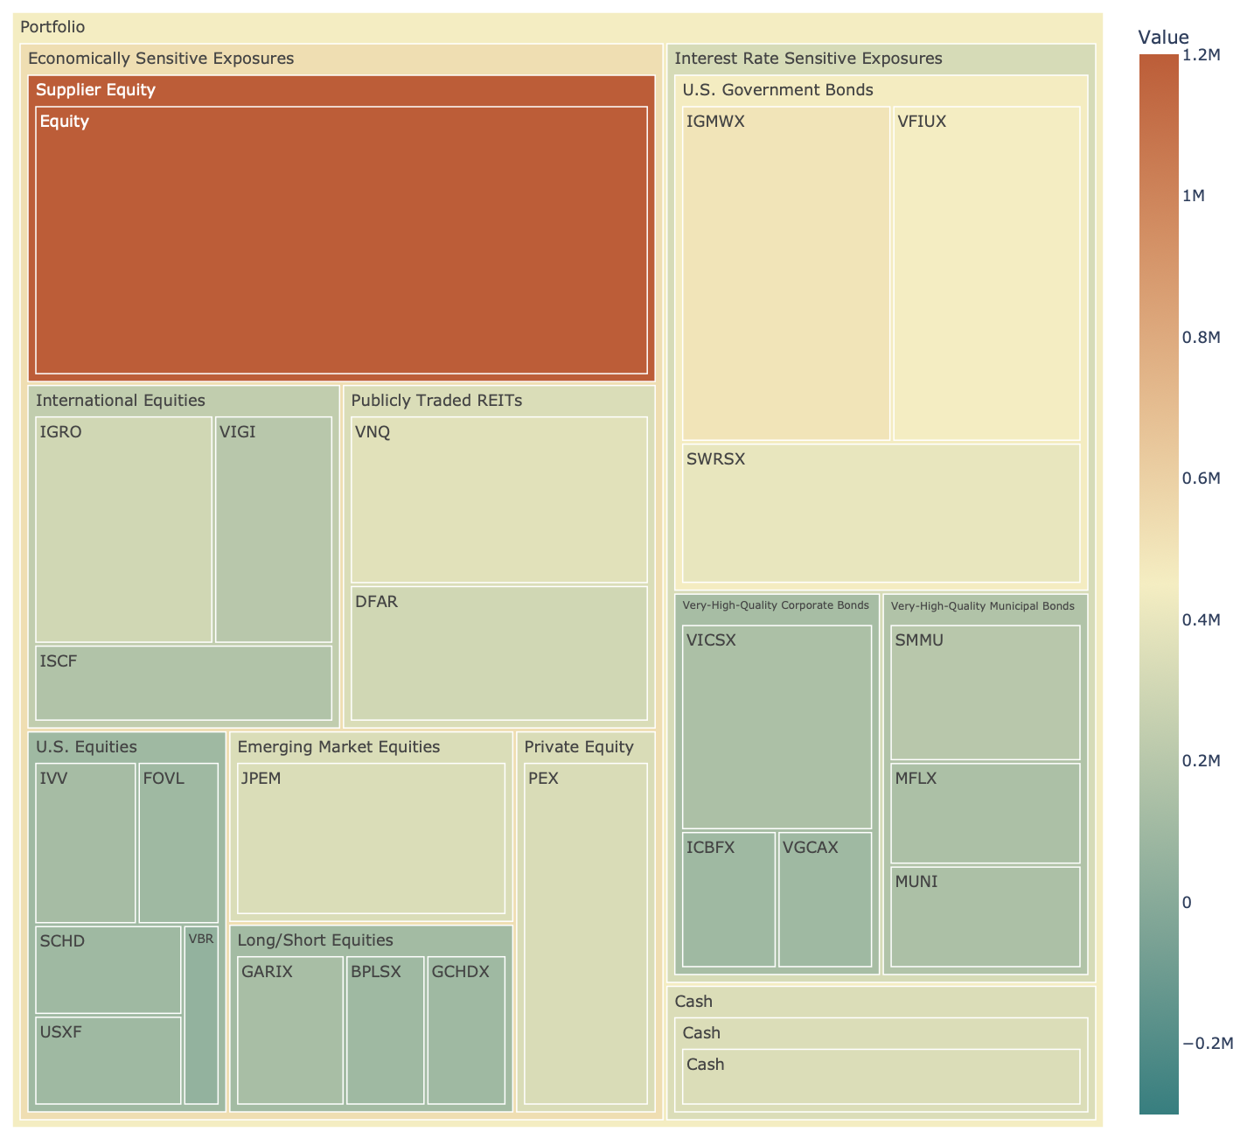
Portfolio Allocation
mutual fund / ETF - Built a portfolio using Mutual Funds and ETF
other options - given the portfolio size other investment options could make sense, Separately Managed Account, Private Equity, Treasury Direct etc
added cash - even though the portfolio includes liquid assets

Slide 6
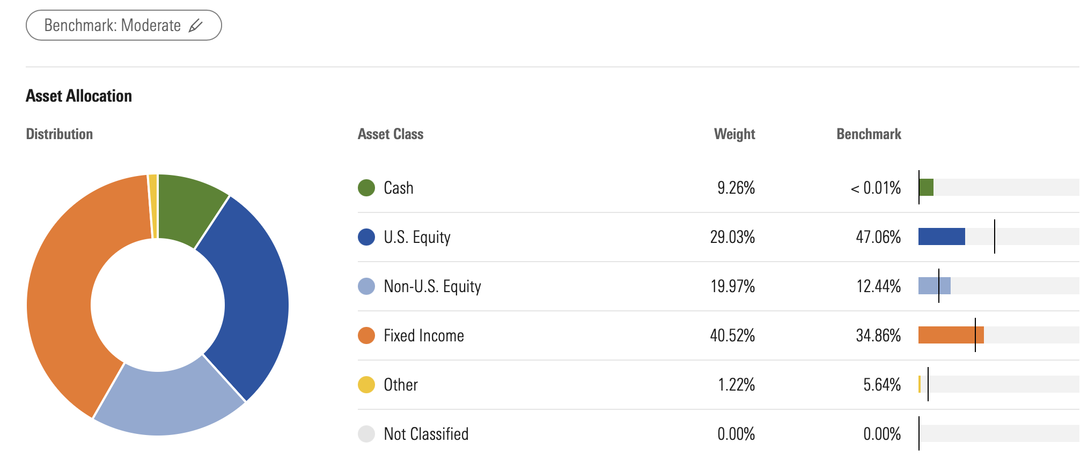
Portfolio Asset Allocation Analysis
moderate risk profile - using the moderate risk profile as a benchmark for the analysis
supplier equity stake - if we include the $1.2M equity holding the portfolio is concentrated and overweight U.S equities
note: analysis provided by morningstar and does not include $1.2M in Supplier Equity

Slide 7
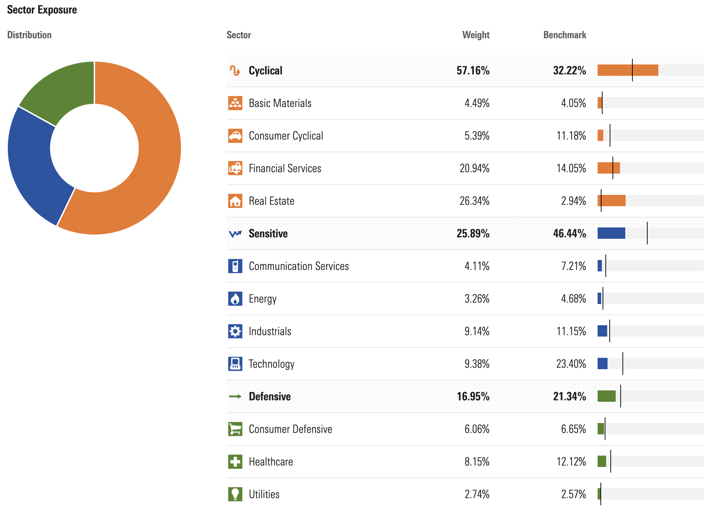
Portfolio Sector Exposure
one of the main drawback on non traditional asset taxonomies is they may not be shared across the industry
overweight cyclical - specifically financial services and real estate
underweight sensitive - specifically technology
balanced defensive - close to recommended weights for defensive
note: analysis provided by morningstar and does not include $1.2M in Supplier Equity

Slide 8
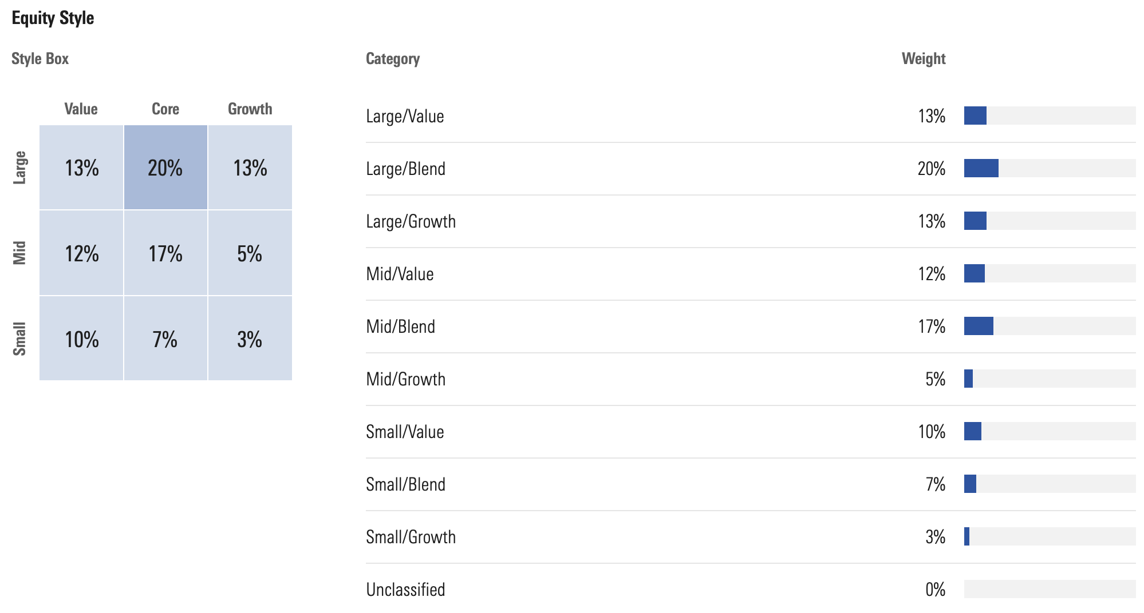
Portfolio Allocation
large cap tilt - emphasis on quality large cap equities
underweight growth - focus on value and core equity styles
note: analysis provided by morningstar and does not include $1.2M in Supplier Equity

Slide 9
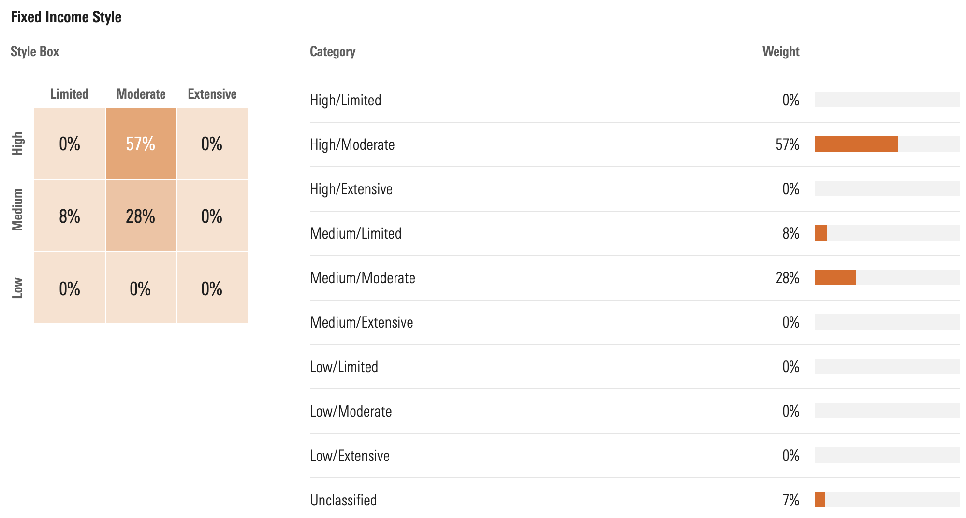
Portfolio Allocation
credit quality tilt - overweight high quality bonds
interest rate sensitivity tilt - focus on moderate interest rate sensitivity. balance risk and return
note: analysis provided by morningstar and does not include $1.2M in Supplier Equity

